Slide 1
IAS Training Program
Report to AA/SIA TAC
September 2019
J.E.J. (Ned) Gravel
IAS Manager, Training

Slide 2
Overview
What was accomplished in 2018 – 300 participants
What is currently planned for 2019
Program Capacity/Capability Development

Slide 3
Overview
What was accomplished in 2018 – 300 participants
What is currently planned for 2019
Program Capacity/Capability Development

Slide 4
Training Conducted in 2019 (so far)
4-5 Feb 19 ISO/IEC 17025:2017 (2 days) Toronto Canada
20-21 Feb 19 IAS AC 291 (2 days) NY
27-28 Feb 19 ISO/IEC 17024:2012 (2 days) Chennai India
2-3 Mar 19 IAF Mandatory Document (IAF MD) Course for MSCBs (2 days) New Delhi India
3-4 Mar 19 ISO/IEC 17025:2017 (2 days) Doha Qatar
4-6 Mar 19 ISO/IEC 17021-1 for MSCBs (3 days) New Delhi India
6-7 Mar 19 Internal Audit Course for 17025 (2 days) Doha Qatar
7 Mar 19 ISO/IEC 17024:2012 (1 day) DC
18-19 Mar 19 ISO/IEC 17025:2017 (2 days) Chicago
20-21 Mar 19 Internal Audit Course for All Standards (2 days) Chicago
25-26 Mar 19 ISO/IEC 17020 for Inspection Agencies (2 days) Brea
8-9 Apr 19 ISO/IEC 17025:2017 (2 days) Bahrain
10-11 Apr 19 Uncertainty of Measurement for labs (2 days) Bahrain

Slide 5
Training Conducted in 2019 (so far)
23 Apr 19 Building Department Accreditation AC426 (1 day) Honolulu
6-7 May 19 Understanding Risk Approach in QMS (1 day) Brea
14-15 May 19 ISO/IEC 17025:2017 (2 days) Brea
16-17 May 19 Uncertainty of Measurement for labs (2 days) Brea
29-31 May 19 AC172, AC472 and AC473 Requirements (3 days) Chicago
15 Jul 19 Building Department Accreditation AC251 (1 day) Birmingham
5-7 Aug 19 ISO/IEC 17021-1 (3 days) Brea
8-9 Aug 19 IAF Mandatory Documents Course (2 days) Brea
13-14 Aug 19 IAS AC 291 (2 days) NY
Legend
Public Courses
From Contract
With Local Partners
22 Courses – 188 People

Slide 6
Online Training Conducted in 2019 (so far)
ISO/IEC 17025:2017 Transition Course – 4 participants
ISO/IEC 17025:2017 Full Course – 5 participants
ISO/IEC 17020:2012 Inspection Bodies – 3 participants

Slide 7
Training Planned for 2019-2 (so far)
18-19 Sep 19 ISO/IEC 17025 (2 days) Washington DC
14 Oct 19 BDA #101 Using AC251 (1 day) Brea CA
15 Oct 19 FDA using AC426 (1 day) Brea CA
16-17 Oct 19 Internal Audit (2 days) Gaithersburg MD
21-22 Oct 19 ISO/IEC 17020 (2 days) Brea CA
3-4 Nov 19 Internal Audit ISO 15189 (3 days) Dammam KSA
17-21 Nov 19 Lead Assessor Course (5 days) Dammam KSA
9-10 Dec 19 ISO/IEC 17025 (2 days) Brea CA
11-12 Dec 19 Uncertainty of Measurement (2 days) Brea CA
9 Courses

Slide 8
Comparing 2018 to Planned 2019
2018 – 24 Courses conducted – 300 people reached.
2019 – 36 Courses planned, 22 conducted – so far 188 people reached.

Slide 9
18 AA/SIA Training Facilitators
Michael Bouse (AC 251 BDA)
Mohan Sabaratnam (17020, 17021, 17025, 17065)
Chuck Ramani (17020, AC 251 BDA, AC 426 FPD)
Craig Joss (17025, 17020, SIA AC291)
David Musselwhite (17065, AC157, and AC172, AC472)
Dean Frank (AC157, Field inspection Bodies)
Doug Hatch (FEB)
Doug Sickles (Testing, SIA AC291, FEB)
Gary Mitchell (AC 472)
George Anastasopoulos (17020, 17021, 17024, 17025, Lead Assessor)
Ian MacDonald (AC 426 FPD)
Kellee Fernandez (AC 251 BDA, AC 426 FPD)
Larry O'Connor (SIA, 17020, AC291)
Ned Gravel (17011, 17025, 17020, 17065, 17043, Metrology, Internal Auditor, Lead Assessor)
Sam Palmer (AC 251 BDA, AC 426 FPD)
Sandi McCracken (Steel Fabrication, AC157, AC172, AC 472, AC478)
Sudhindra Ananda Rao (17025, Metrology, Lead Assessor, 17020)
Walter Mershon (AC478)

Slide 10
Program Development
Standardize IAS Training Courses (CONTINUING)
Establish Partnerships in Regions outside the US (GROWING)
Establish and Maintain Contact with potential participants (COMPLETE)
Develop Online Training Presence (COMPLETE)
Implement Marketing to our Captive Market (UNDERWAY)
Implement Common Feedback Approach (UNDERWAY)

Slide 11
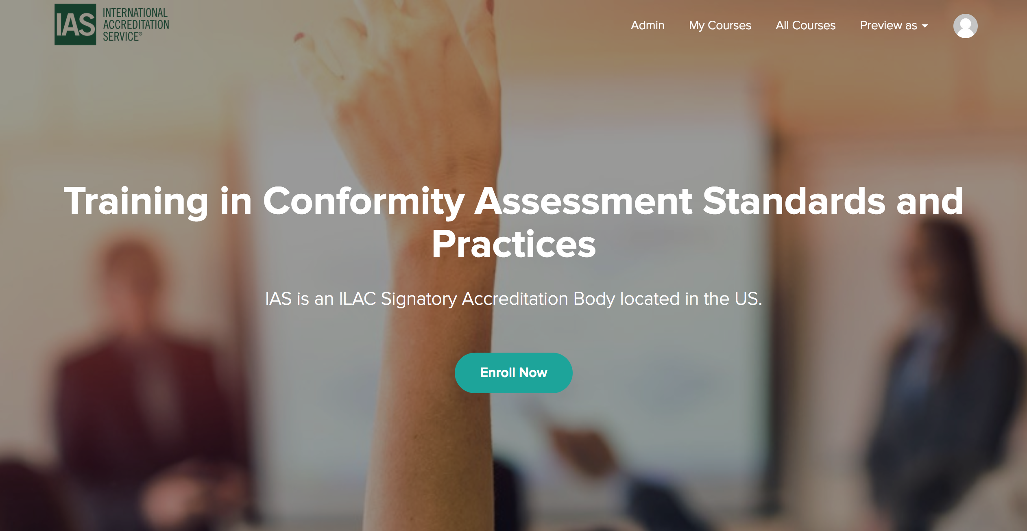
Online Training for IAS

Slide 12
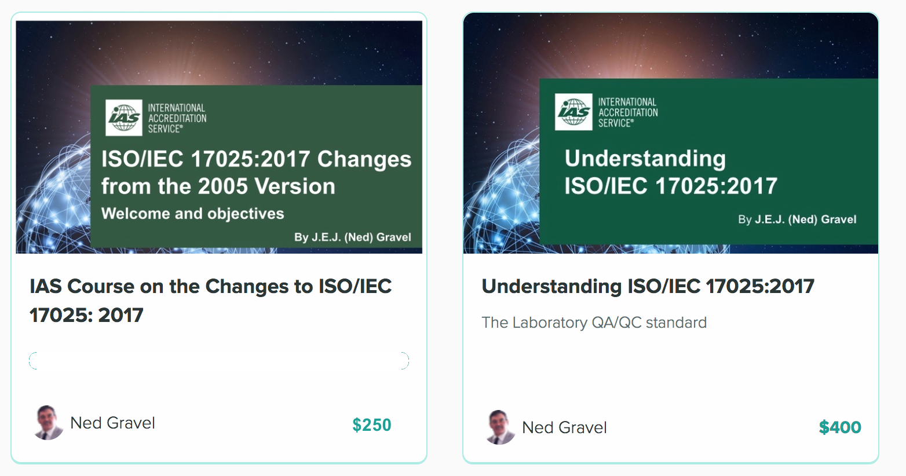
Online Training for IAS

Slide 13
Thank you!
J.E.J. (Ned) Gravel, CD, PEng, CA-LS, CAE, IPL
Training Manager, IAS

